Slide 1

CAPSTONE PROJECT PRESENTATION
Name: Kenmogne, Jean
Date: September 9, 2020
Email: kenmogne12@gmail.com

Slide 2
CAPSTONE OVERVIEW
Provide answers to questions listed in PCAPs.
Pcap File Name
Title the screenshots with a few words of explanation
Pcap Screenshot
Summarize your analysis with a brief description of each pcap file
Project Summary

Slide 3
Objectives of the Capstone Project
The project require the examination of 5 pcaps file. For each pcap file:
Demo each using Wireshark
Provide answers to questions
Take screenshots and title them
Provide brief summary for each pcap file
Use the ppt for the presentation of the pcap file.

Slide 4
THE 5 PCAPS FILE:
PCAP #1 host_and_user_id-pcap-04.pcapng
PCAP #2 host_and_user_id-pcap-05.pcapng
PCAP #3 arppoison.pcapng
PCAP #4 tcp_handshake.pcapng
PCAP #5 tcp_ports.pcapng

Slide 5
PCAP #1 host_and_user_id-pcap-04.pcapng
Answer these questions here in this slide (this is your “incident report”) If you need more space, add another slide. Answer the questions in the directions document for each pcap. Use these questions to ADD data that you think would illuminate your analysis.
Is this an exploit or normal traffic : normal traffic
What are the addresses of the main devices in the conversation? (IP, MAC, Ports): Src IP: 172.16.4.119 – MAC: 00:57:c1:a9:cb:46 – Port: 14906; Dst IP: 8.8.8.8 – MAC: 20:e5:2a:b6:93:f1 – Port: 53
If an exploit, what exploit (virus, etc) is present and what device is the victim of the exploit? MITM attack
If it is normal traffic, what activity is being traced. Include details (i.e. if it is a DNS trace, what is the web address, if it’s there that is being queried, etc.) Normal HTTP traffic
If you needed to use a protocol filter, what did you use and why? A protocol filter accept or reject packets based on the criteria selected. If a filter is enabled, any packet that do not match the conditions set in that filter is discarded.
If it is an exploit, what would you suggest to mitigate it? (i.e. if it is a man in the middle, what would you suggest to prevent it?) A strong encryption mechanism on wireless access points prevents unwanted users from joining your network just by being nearby – Strong Router Login Credentials - VPNs can be used to create a secure environment for sensitive information within a local area network – Force HTTPS - Public Key Pair Based Authentication
If it is normal traffic, no mitigation is necessary.
Any other addition information you think is important: This pcap is from an Android host using an internal IP address at 172.16.4.119

Slide 6
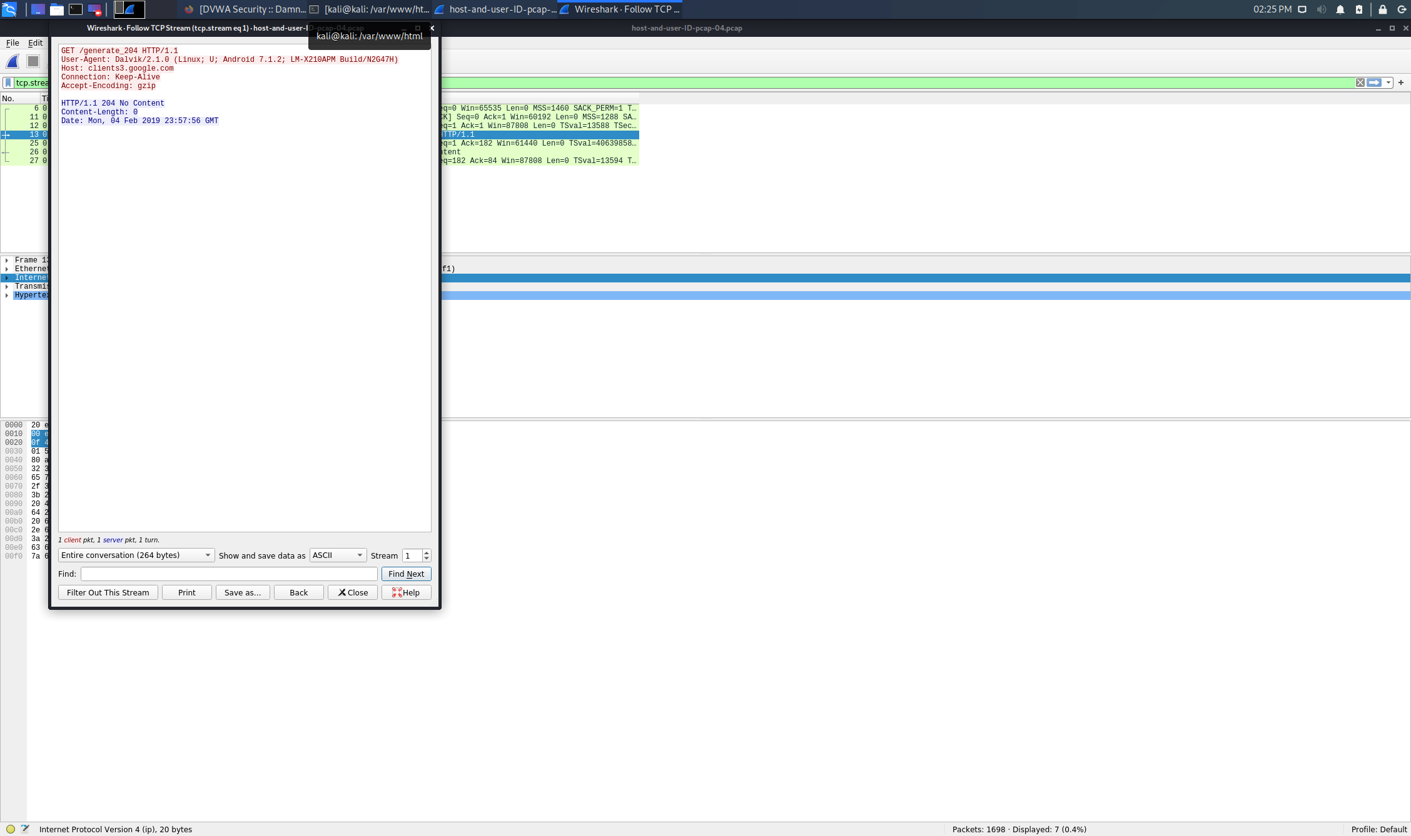
host_and_user_id-pcap-04.pcapng Screenshot/s
Short description of screenshot 1:
Right clicking the frame #13, Follow and TCP Stream, we can recall the OS under the User-Agent and read the Host name

Slide 7
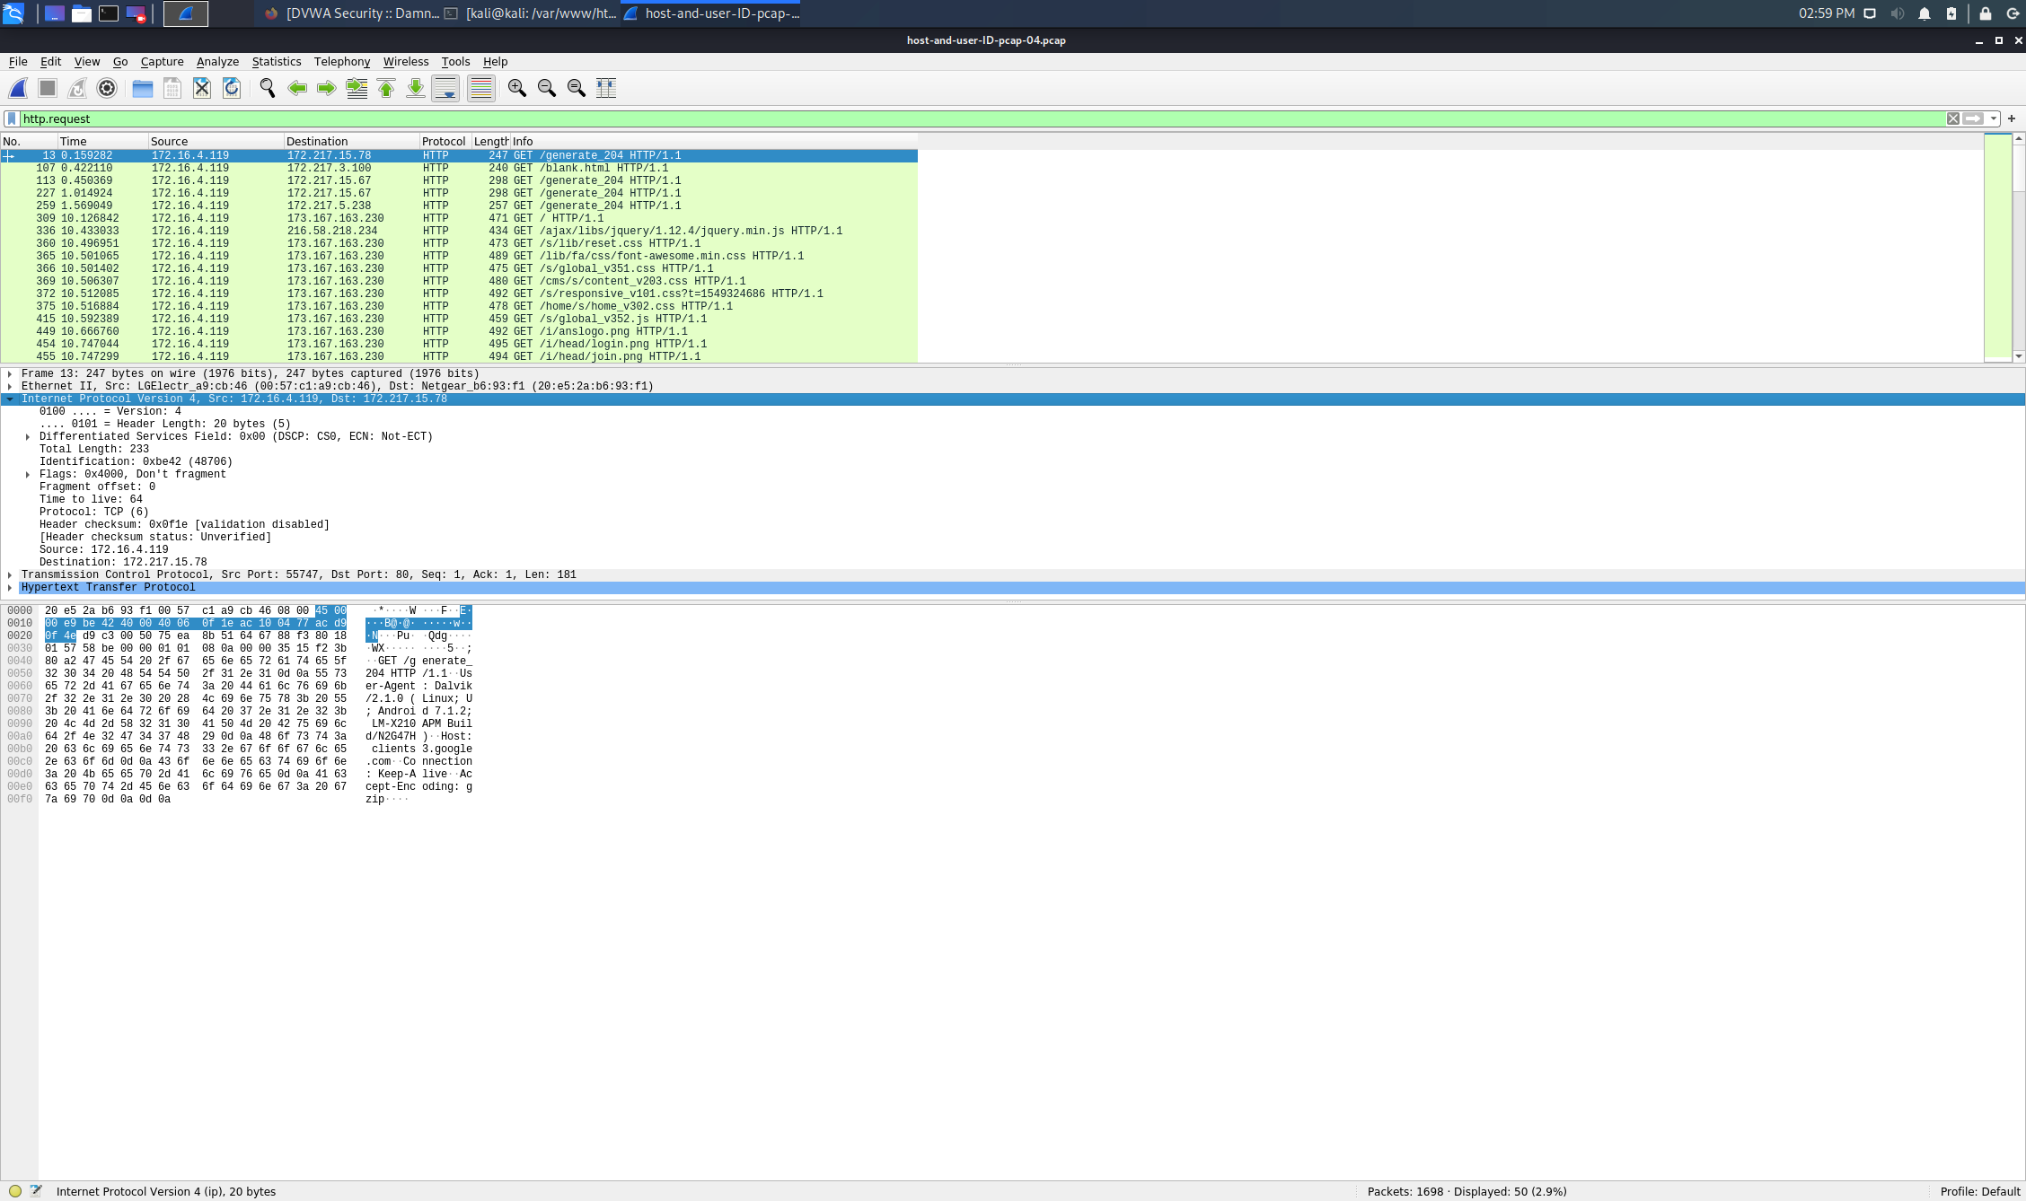
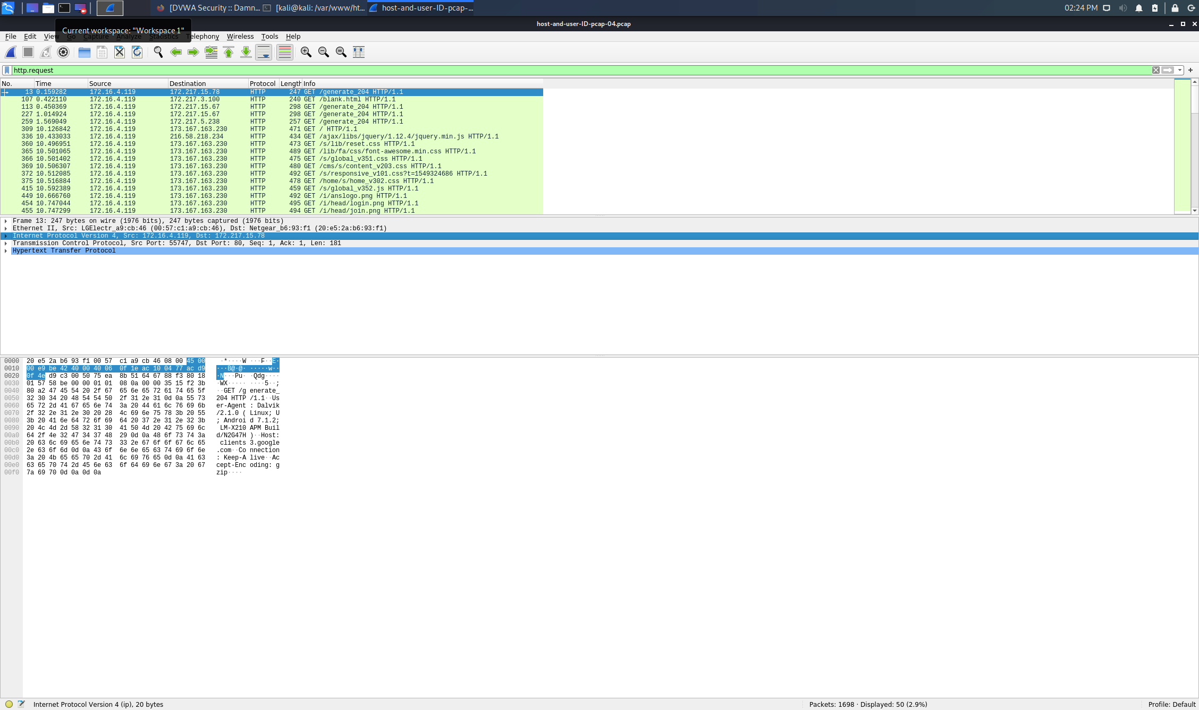
host_and_user_id-pcap-04.pcapng Screenshot/s (‘d)
Short description of screenshot 2:
filter on HTTP.request
Short description of screenshot 3:
filter on HTTP.request

Slide 8
PCAP #2 host_and_user_id-pcap-05.pcapng
Answer these questions here in this slide (this is your “incident report”) If you need more space, add another slide. Answer the questions in the directions document for each pcap. Use these questions to ADD data that you think would illuminate your analysis.
Is this an exploit or normal traffic: An exploit
What are the addresses of the main devices in the conversation? (IP, MAC, Ports): Src IP: 10.0.0.114 – MAC: b0:ca:68:15:e9:f2 – Port: 49152; Dst IP: 17.253.21.208 – MAC: 4c:ed:fb:68:bf:6f – Port: 80
If an exploit, what exploit (virus, etc) is present and what device is the victim of the exploit? iPhone
If it is normal traffic, what activity is being traced. Include details (i.e. if it is a DNS trace, what is the web address, if it’s there that is being queried, etc.)
If you needed to use a protocol filter, what did you use and why? HTTP.request. If enabled, any packet that do not match the set conditions is discarded.
If it is an exploit, what would you suggest to mitigate it? (i.e. if it is a man in the middle, what would you suggest to prevent it?) A strong encryption mechanism on wireless access points prevents unwanted users from joining your network just by being nearby – Strong Router Login Credentials - VPNs can be used to create a secure environment for sensitive information within a local area network – Force HTTPS - Public Key Pair Based Authentication
If it is normal traffic, no mitigation is necessary
Any other addition information you think is important: Note about HTTP traffic and User-Agent strings: not all HTTP activity is web browsing traffic. Some HTTP requests will not reveal a browser or operating system. When you search through traffic to identify a host, you might have to try several different HTTP requests before finding web browser traffic. Since more websites are using HTTPS, this method of host identification can be difficult. HTTP headers and content are not visible in HTTPS traffic. However, for those lucky enough to find HTTP web-browsing traffic during their investigation, this method can provide more information about a host.

Slide 9
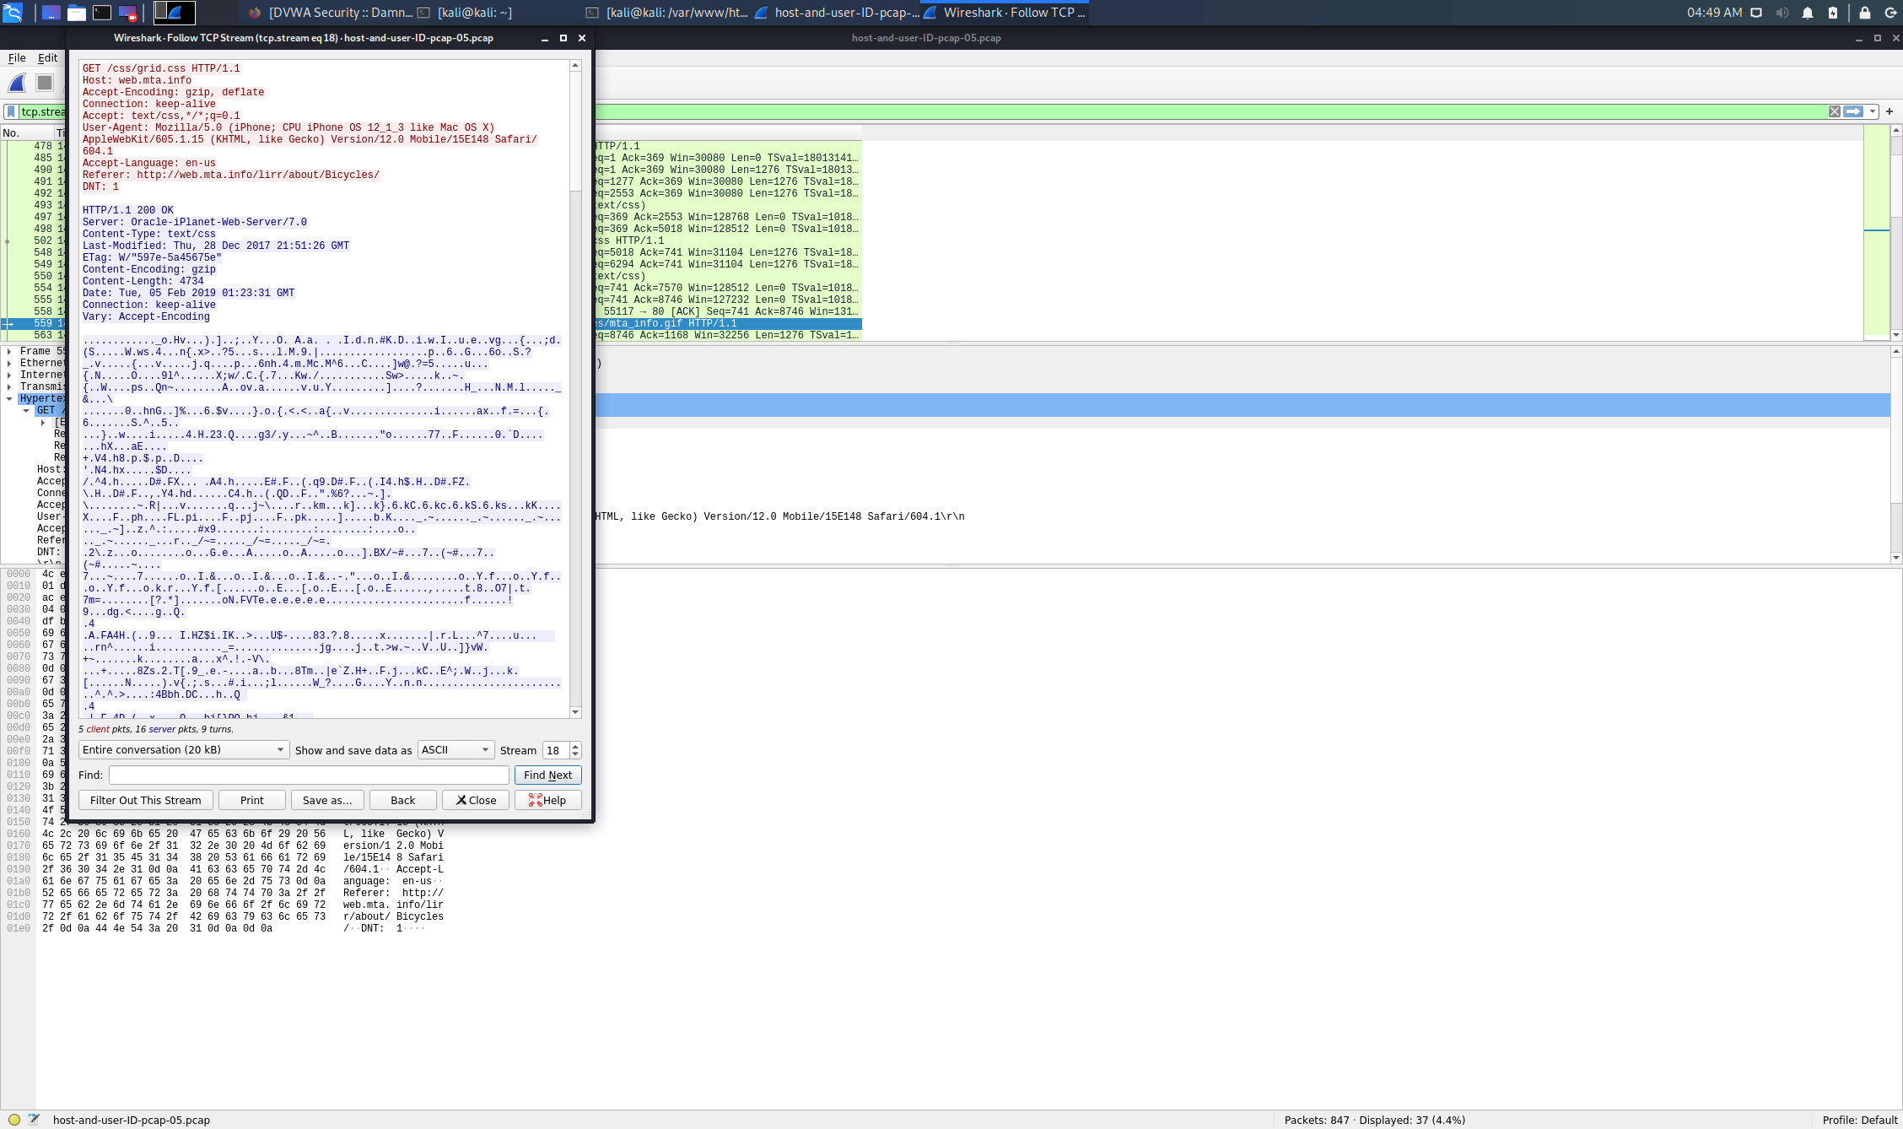
host_and_user_id-pcap-05.pcapng Screenshot/s
Short description of screenshot 1:
TCP Stream showing the Host and the User-Agent. The User-Agent line shows (iPhone; CPU iPhone OS 12_1_3 like Mac OS X). This indicates the Apple device is an iPhone, and it is running iOS 12.1.3

Slide 10
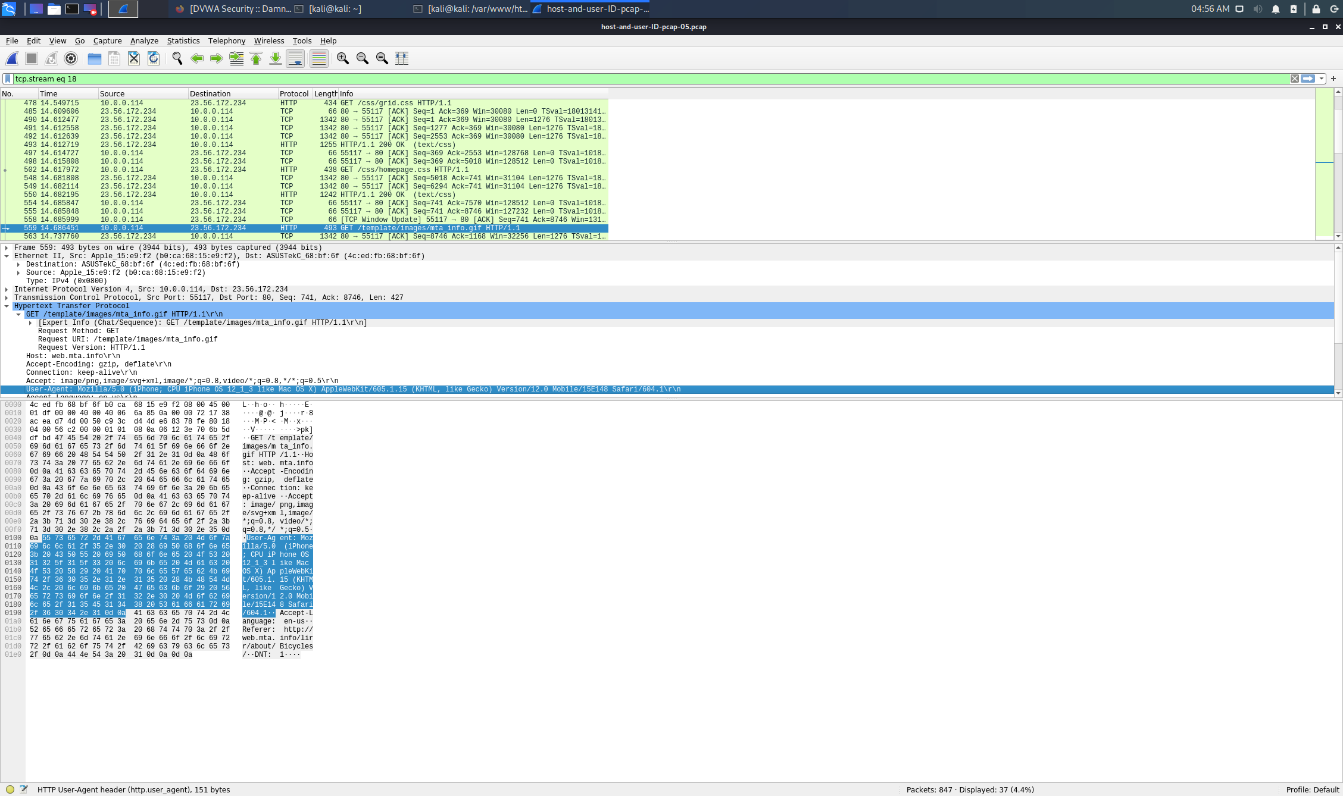
host_and_user_id-pcap-05.pcapng Screenshot/s (‘d)
Short description of screenshot 2:
Filter on HTTP.request we can recall Src and Dst IP-MAC-Port and sequence number.

Slide 11
PCAP #3 arppoison.pcapng
Answer these questions here in this slide (this is your “incident report”) If you need more space, add another slide. Answer the questions in the directions document for each pcap. Use these questions to ADD data that you think would illuminate your analysis.
Is this an exploit or normal traffic: An exploit: ARP Spoofing
What are the addresses of the main devices in the conversation? (IP, MAC, Ports): Src IP: unknown – MAC: 00:25:b3:bf:91:ee – Dst IP: 172.16.0.107 – MAC: 00:21:70:c0:56:f0
If an exploit, what exploit (virus, etc) is present and what device is the victim of the exploit?
If it is normal traffic, what activity is being traced. Include details (i.e. if it is a DNS trace, what is the web address, if it’s there that is being queried, etc.)
If you needed to use a protocol filter, what did you use and why?
If it is an exploit, what would you suggest to mitigate it? (i.e. if it is a man in the middle, what would you suggest to prevent it?)
If it is normal traffic, no mitigation is necessary
Any other addition information you think is important: ARP poisoning involves sending forged ARP reply packets to a gateway over the local network. ARP poisoning is a type of man-in-the-middle (MITM) attack that can be used to stop network traffic, change it or intercept it. The technique is often used to initiate further offensives such as session hijacking or denial-of-service.

Slide 12
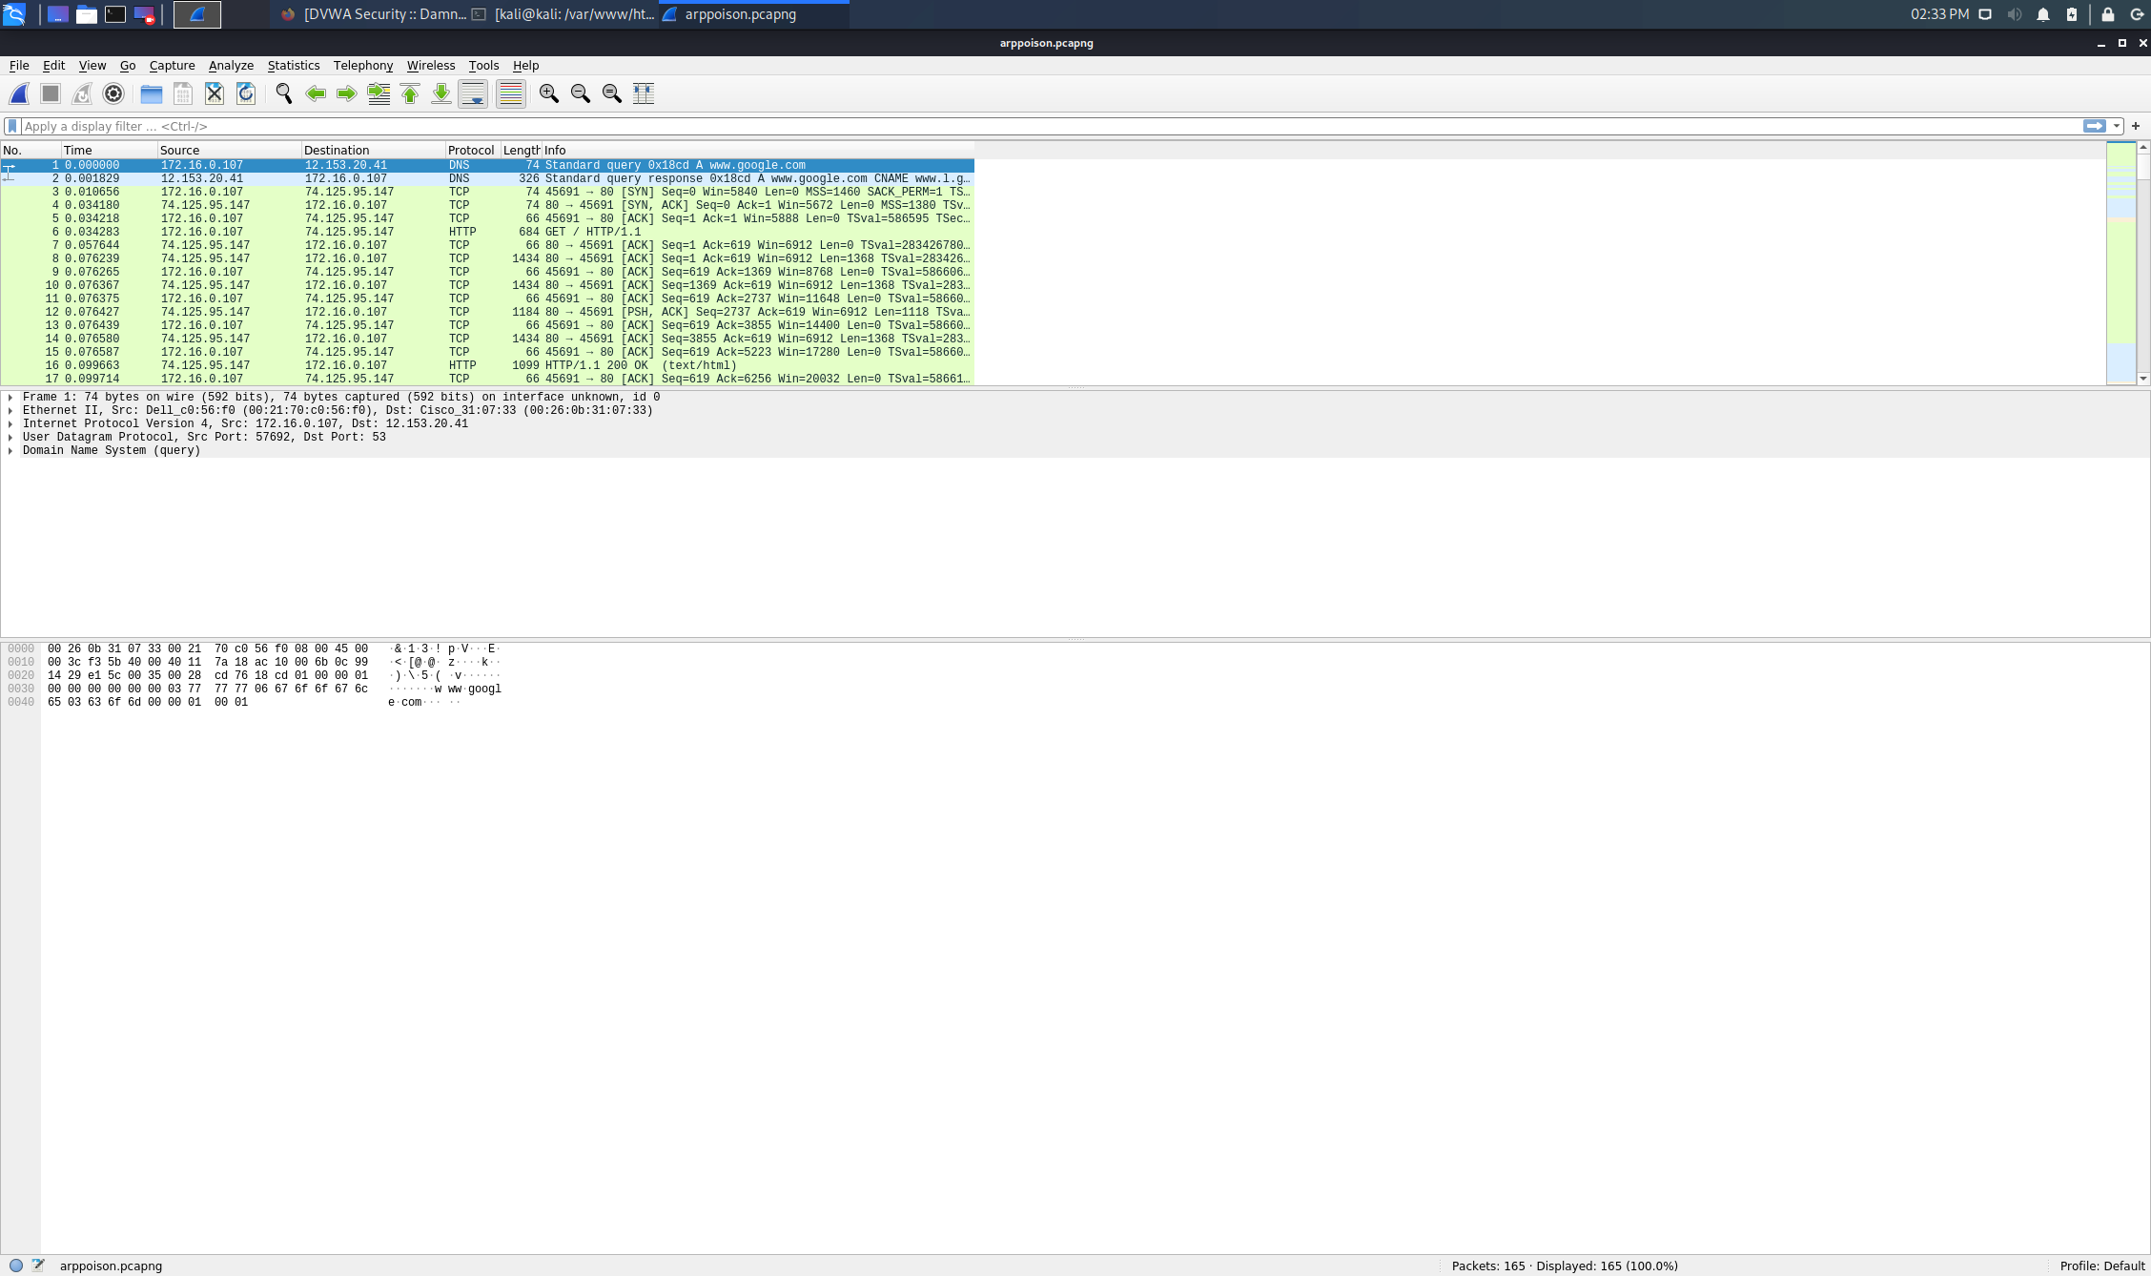
arppoison.pcapng Screenshot/s
Short description of screenshot 1
WHAT IS ARP POISONING?
ARP poisoning involves sending forged ARP reply packets to a gateway over the local network. Attackers typically use spoofing tools like Arpspoof or Arppoison to make the job easy. They set the IP address of the tool to match the address of their target. The tool then scans the target LAN for the IP and MAC addresses of its hosts.
HOW TO PREVENT ARP POISONING?
Static ARP entries: This solution involves a lot of administrative overhead and is only recommended for smaller networks. It involves adding an ARP entry for every machine on a network into each individual computer. Unfortunately, this solution can only protect you from simpler attacks.
Encryption: Protocols such as HTTPS and SSH can also help to reduce the chances of a successful ARP poisoning attack. When traffic is encrypted, the attacker would have to go to the additional step of tricking the target’s browser into accepting an illegitimate certificate. However, any data transmitted outside of these protocols will still be vulnerable.
VPN: A VPN can be a reasonable defense for individuals, but they are generally not suitable for larger organizations. If it is just a single person making a potentially dangerous connection, such as using public wifi at an airport, then a VPN will encrypt all of the data that travels between the client and the exit server. This helps to keep them safe, because an attacker will only be able to see the ciphertext. It’s a less-feasible solution at the organizational level, because VPN connections would need to be in place between each computer and each server. Not only would this be complex to set up and maintain but encrypting and decrypting on that scale would also hinder the network’s performance.
Packets Filter: These filters analyze each packet that gets sent across a network. They can filter out and block malicious packets, as well as those whose IP addresses are suspicious. Packet filters can also tell if a packet claims to come from an internal network when it actually originates externally, helping to reduce the chances of an attack being successful.

Slide 13
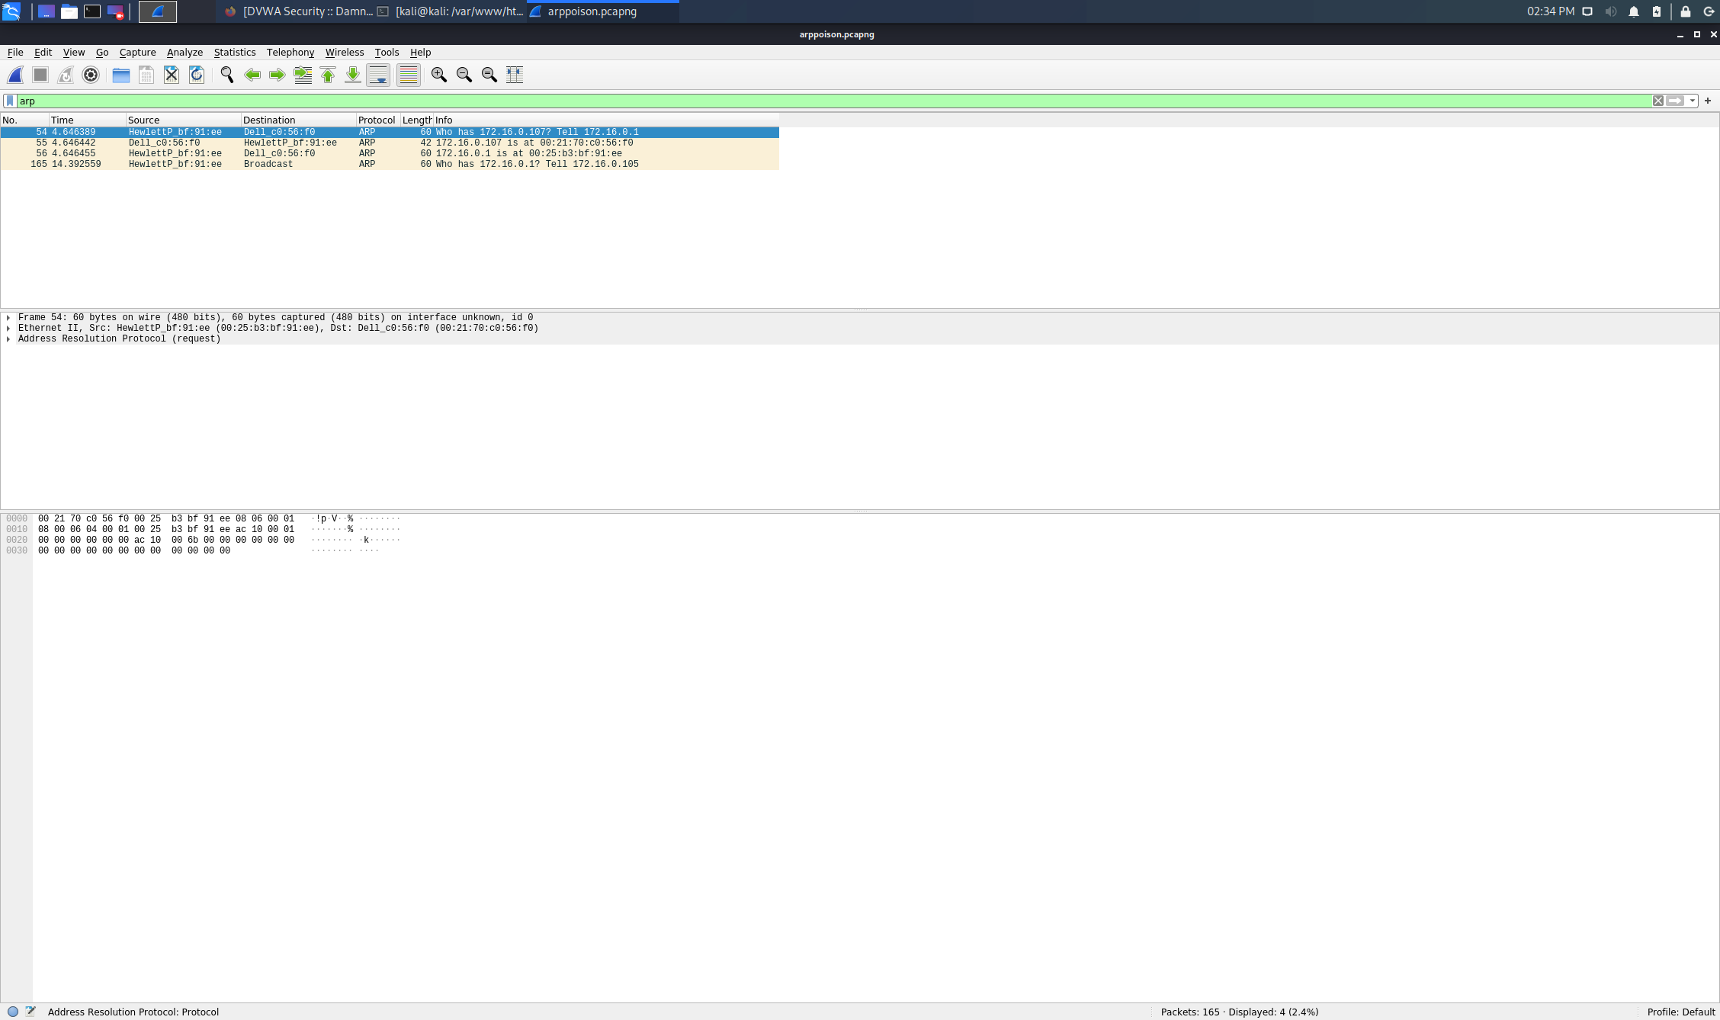
arppoison.pcapng Screenshot/s
Short description of screenshot 2:
Filter on ARP, the 3 frames containing the main ARP poisoning are: 54-55-56

Slide 14
PCAP #4 tcp_handshake.pcapng
Answer these questions here in this slide (this is your “incident report”) If you need more space, add another slide. Answer the questions in the directions document for each pcap. Use these questions to ADD data that you think would illuminate your analysis.
Is this an exploit or normal traffic: An exploit
What are the addresses of the main devices in the conversation? (IP, MAC, Ports): Src IP: 172.16.16.128 – MAC: 00:21:6a:5b:7d:4a – Port: 2826; Dst IP: 212.58.226.142 – MAC: 00:05:5d:21:99:4c – Port: 80
If an exploit, what exploit (virus, etc) is present and what device is the victim of the exploit?
If it is normal traffic, what activity is being traced. Include details (i.e. if it is a DNS trace, what is the web address, if it’s there that is being queried, etc.)
If you needed to use a protocol filter, what did you use and why?
If it is an exploit, what would you suggest to mitigate it? (i.e. if it is a man in the middle, what would you suggest to prevent it?)
If it is normal traffic, no mitigation is necessary
Any other addition information you think is important: The three-way handshake is the protocol procedure to set up both way connection with the peer TCP.

Slide 15
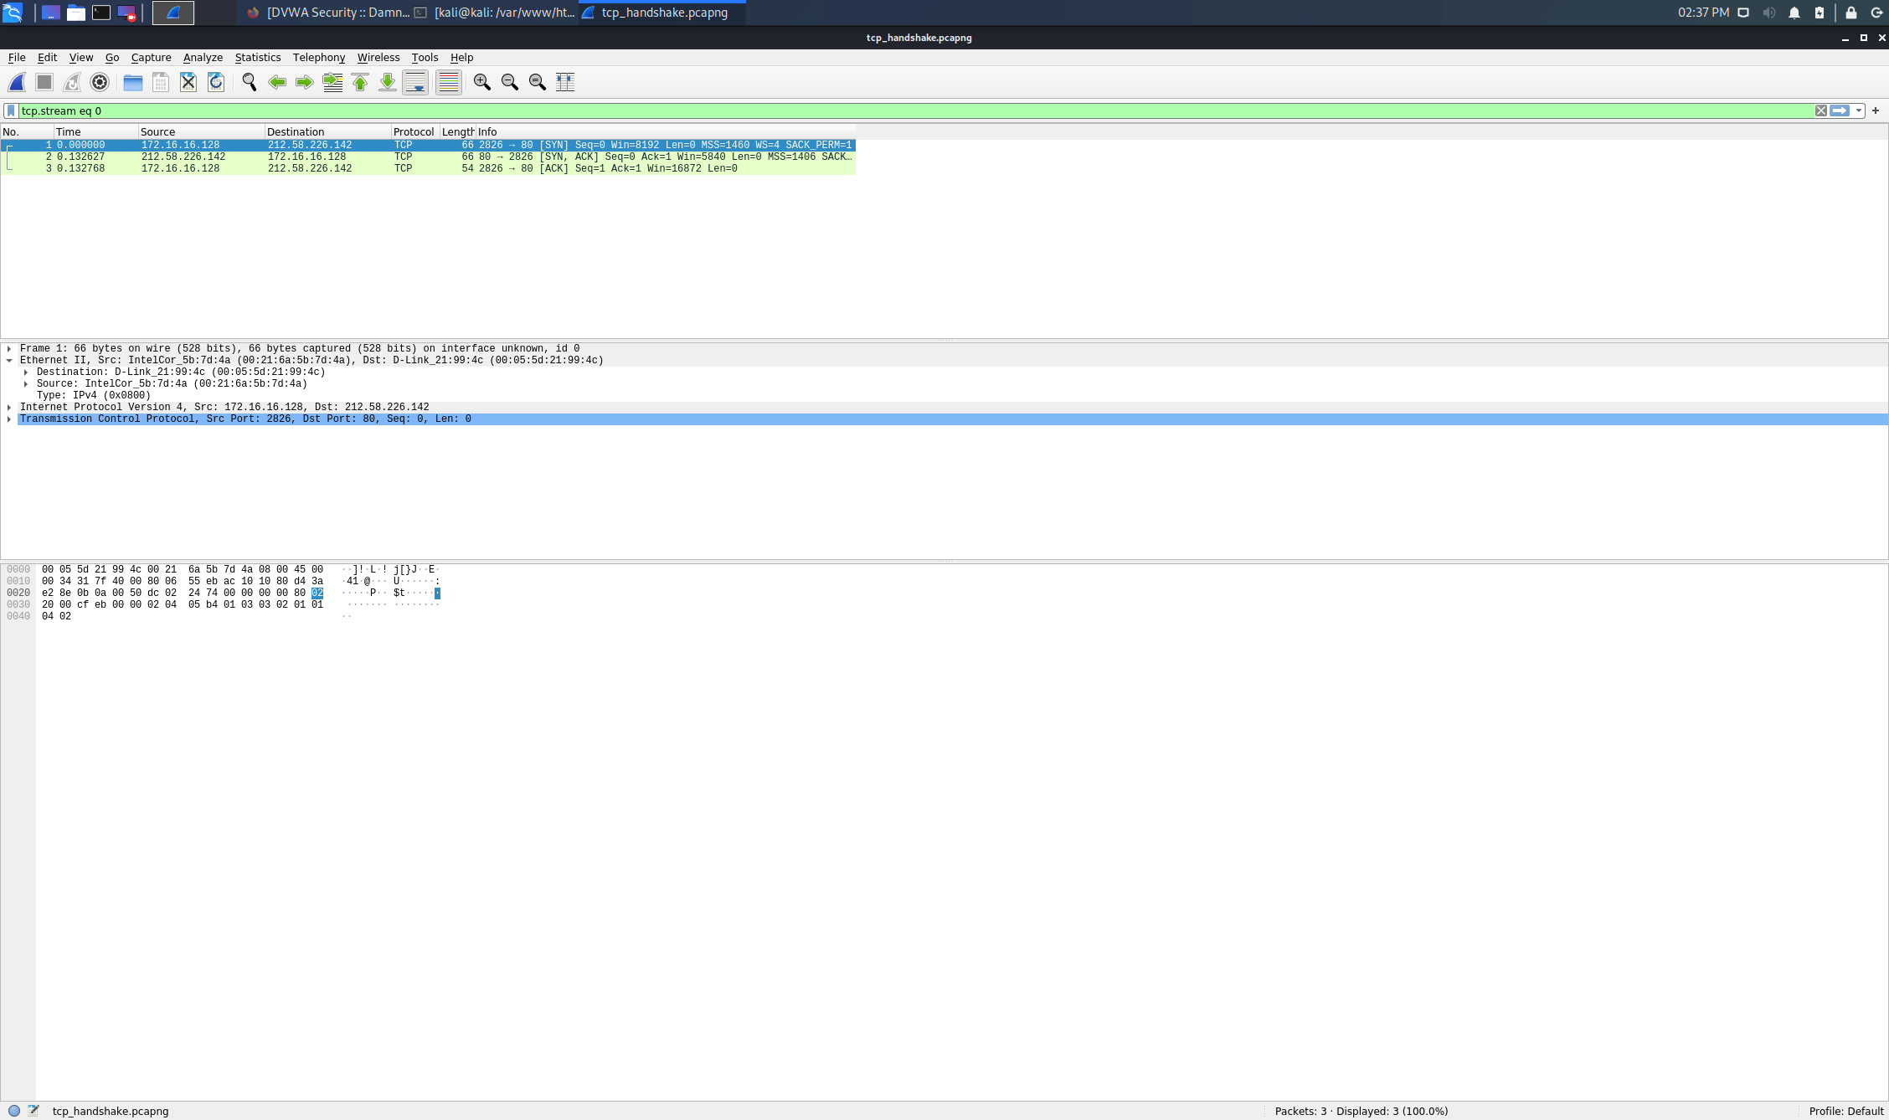
tcp_handshake.pcapng Screenshot/s
Short description of screenshot 1
The three-way handshake is the protocol procedure to set up both way connection with the peer TCP.
The user of HTTP issues a connect request to the TCP layer. TCP layer works as a TCP Client and sends the TCP syn with an initial sequence number. The sequence number is to maintain the sequencing of messages. Because TCP delivers messages to the user in sequence. Upon SYN received Sever sends a new syn and an ack for a received SYN to the client, then the client sends the ACK to the server for a received SYN from the server. This completes the connection setup.

Slide 16
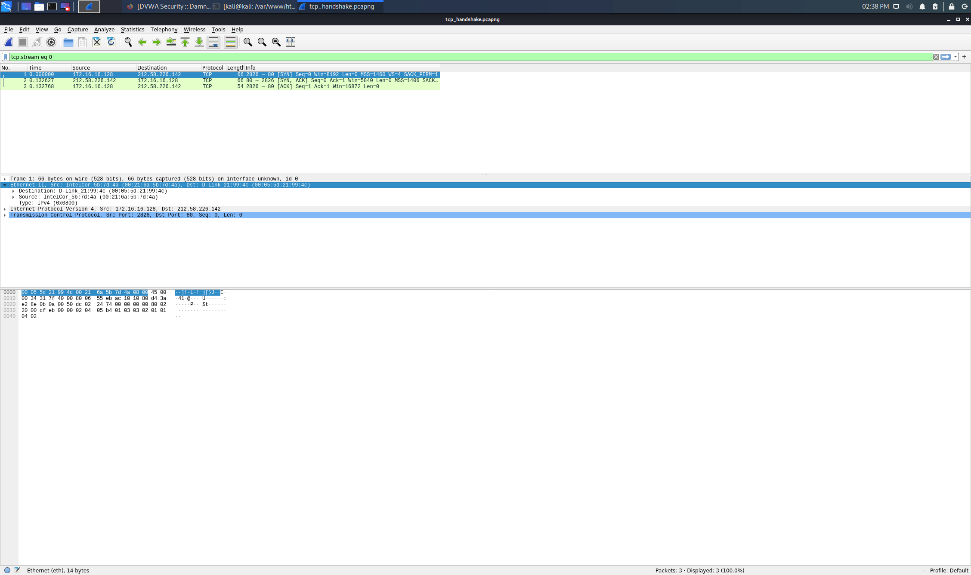
tcp_handshake.pcapng Screenshot/s
Short description of screenshot 2
TCP SYN packet:
This is the first packet from the client to the server. TCP message set SYN flag to 1 in the message, so make the TCP message as SYN segment. It has the initial sequence number of the client along with other few more parameters.
TCP SYN-ACK packet:
After receiving the SYN packet, the server sends the syn ack packet to the client. Not to mention that this is a single TCP packet with syn and ack bit set to 1. The syn sequence number is the initial sequence number of the server accepting the connection. The ack part has the client sequence number plus one. This way server tells that it is ready to accept the packet with the next sequence number from the client.
TCP ACK packet:
The final packet for the connection setup is TCP ack. The client sends a TCP ack packet upon receiving TCP syn ack from the server. The packet includes a sequence number from the server plus one.

Slide 17
PCAP #5 tcp_ports.pcapng
Answer these questions here in this slide (this is your “incident report”) If you need more space, add another slide. Answer the questions in the directions document for each pcap. Use these questions to ADD data that you think would illuminate your analysis.
Is this an exploit or normal traffic: A normal traffic – DNS retransmission
What are the addresses of the main devices in the conversation? (IP, MAC, Ports): Src IP: 172.16.16.128 – MAC: 00:21:6a:5b:7d:4a – Port: 2826; Dst IP: 212.58.226.142 – MAC: 00:05:5d:21:99:4c – Port: 80
If an exploit, what exploit (virus, etc) is present and what device is the victim of the exploit?
If it is normal traffic, what activity is being traced. Include details (i.e. if it is a DNS trace, what is the web address, if it’s there that is being queried, etc.)
If you needed to use a protocol filter, what did you use and why?
If it is an exploit, what would you suggest to mitigate it? (i.e. if it is a man in the middle, what would you suggest to prevent it?)
If it is normal traffic, no mitigation is necessary
Any other addition information you think is important: Port filtering is the way of filtering packets based on port number.

Slide 18
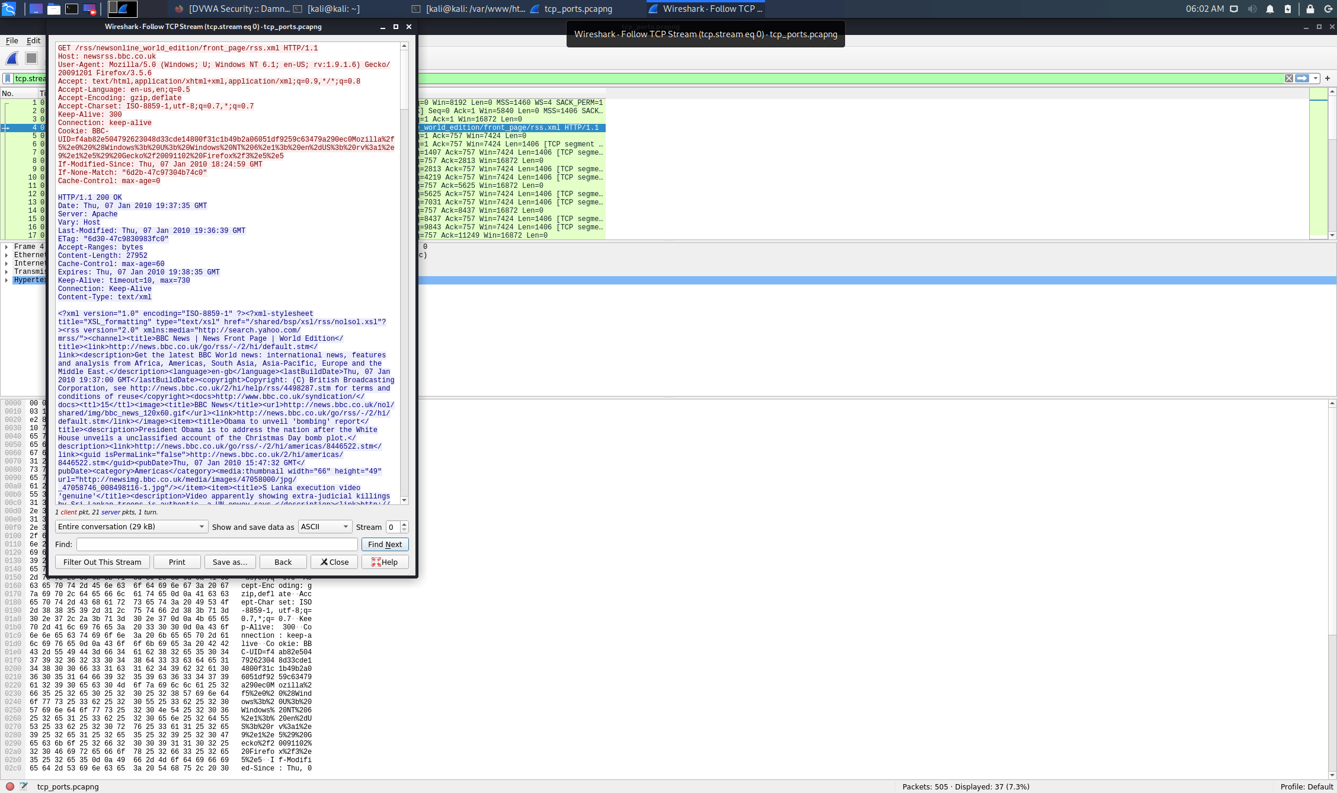
tcp_ports.pcapng Screenshot/s
Short description of screenshot 1:
Notice the User-Agent line that has Windows NT 6.1 (Windows 7) and the version of Firefox 3.5.6
The Content-Type is text/xml
Host: newsrrs.bbc.co.uk

Slide 19
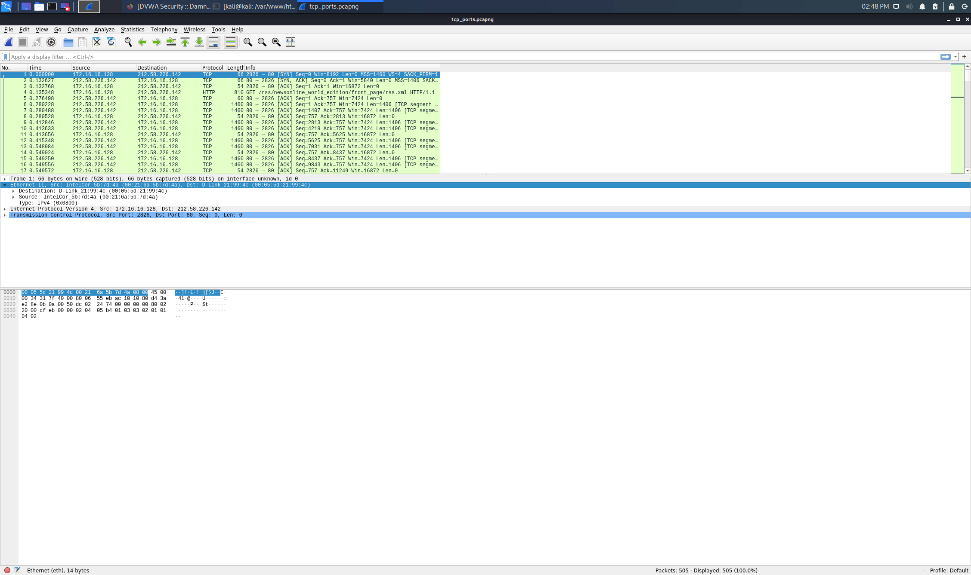
tcp_ports.pcapng Screenshot/s
Short description of screenshot 2

Slide 20
Presentation Summary
Provide an overview of your findings for each PCACP (1 – 2 sentences)
PCAP #1: User-agent strings from headers in HTTP traffic can reveal the operating system. If the HTTP traffic is from an Android device, you might also determine the manufacturer and model of the device.
PCAP #2: Some HTTP requests will not reveal a browser or operating system. When you search through traffic to identify a host, you might have to try several different HTTP requests before finding web browser traffic. Since more websites are using HTTPS, this method of host identification can be difficult

Slide 21
Presentation Summary
PCAP #3: This file contains an example of ARP cache poisoning. When you open it, you will see that the traffic appears normal at first glance. Following the packets, you see the target 172.16.0.107 browsing to Google and performing a search. As a result, a quite bit of HTTP traffic with some DNS queries mixed in. ARP poisoning involves sending forged ARP reply packets to a gateway over the local network. Attackers typically use spoofing tools like Arpspoof or Arppoison to make the job easy. They set the IP address of the tool to match the address
of their target. The tool then scans the target LAN for the IP and MAC addresses of its hosts.
Once the attacker has the addresses of the hosts, they start sending forged ARP packets over the local network to the hosts. The fraudulent messages tell the recipients that the attacker’s MAC address should be connected to the IP address of the machine they are targeting.

Slide 22
Presentation Summary
Provide an overview of your findings for each PCACP (1 – 2 sentences)
PCAP #4: The protocol is connection-oriented, means before sending any data to the remote peer, TCP client set up a virtual connection over a packet-based underlying IP network. The three-way handshake is the protocol procedure to set up both way connection with the peer TCP.
PCAP #5: The ultimate goal of the Transmission Control Protocol is to provide end-to-end reliability for the delivery of data. TCP is considered connection-oriented protocol because it establishes a formal connection before transmitting data, tracks packet delivery, and usually attempts to formally close communication channels when transmission is complete. Many commonly used application-layer protocols rely on TCP and IP to deliver packets to their final destination.

